Slide 1

IBB Wi-Fi Pulse: Smart Density Prediction
Analytics for City-Wide Network Optimisation
Internet of Things and Applied Data Science
Professor: Dr Mehmet Ali Akyol
Team Data Wave:
• Al-Baraa Al-Qaisi (231023203)
• Farag Gaafar (221023204)

Slide 2

The Challenge: Network Planning in a Metropolis
The Context
Istanbul Metropolitan Municipality (IBB) operates one of Europe's largest public Wi-Fi networks, serving millions of residents and tourists across 39 districts. However, subscriber growth patterns remain uneven and challenging to predict, creating significant operational challenges for network planning teams.
The Problem
Without granular, actionable usage analytics, city planners struggle to determine optimal locations and timing for new access point installations. This reactive approach leads to service gaps, wasted infrastructure investment, and diminished public trust in network reliability.
The Goal
Our mission is to transform raw connection data into a sophisticated decision-support tool that empowers IBB's IT department to make proactive, evidence-based infrastructure investments. By predicting demand patterns before they materialise, we enable strategic rather than reactive network expansion.

Slide 3

From Raw Logs to Actionable Intelligence
This project transforms years of disconnected network logs into a comprehensive analytical framework spanning data engineering, visualisation, and predictive modelling.
01
02
Data Cleaning & Preparation
Interactive Visualisation
Transform messy, inconsistent raw connection logs into a structured, analytically usable format. This foundation ensures all downstream analysis is built on reliable data.
Develop a live, web-based dashboard that maps connection density across Istanbul's districts in real-time, enabling spatial pattern recognition and temporal trend analysis.
03
Predictive Forecasting
Build and validate machine learning models to estimate subscriber counts for the coming two years, providing strategic foresight for infrastructure planning and budget allocation.

Slide 4

The Dual-Sensor Data Source
Sensor A: Physical Layer
Wireless Access Points (WAPs)
Physical infrastructure deployed strategically across Istanbul's 39 districts. These devices continuously detect device presence, measure signal strength, and monitor connection quality. Each WAP functions as a sophisticated sensor capturing real-world network utilisation patterns.
Sensor B: Virtual Layer
Network Authentication Loggers
Software-based monitoring systems that capture rich session metadata including precise timestamps, geographic location tags, session duration, data usage volumes, and device types. These virtual sensors provide the granular detail necessary for advanced analytics.
Together, these complementary sensing layers generate comprehensive "Session Logs" dating back to 2016, forming a robust foundation for spatiotemporal analysis and predictive modelling.

Slide 5




Data Preprocessing & Sanitisation
Preprocessing Pipeline
Normalisation
Correcting inconsistent date and time formats to ensure compatibility with time-series analysis tools and enable accurate temporal aggregation.
Filtration
Systematically removing records with missing or invalid spatial data (location coordinates) that would compromise geographic analysis accuracy.
Standardisation
Converting ambiguous tags and labels (e.g., "Bilinmiyor" to "Unidentified") to ensure consistency and analytical precision across the entire dataset.
Data Source
IBB Open Data Portal provides public access to historical Wi-Fi session logs, representing years of network activity across the city.
This rigorous preprocessing transforms unreliable raw data into a clean, structured foundation ready for sophisticated analysis and machine learning applications.

Slide 6
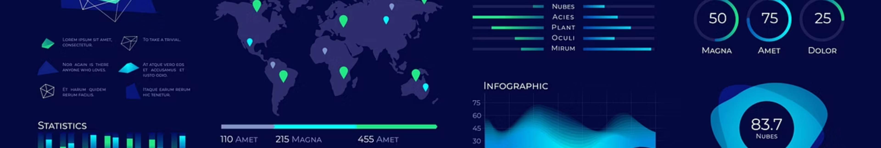



Interactive Dashboard Architecture
Streamlit Platform
Dynamic Filtering
Geospatial Mapping
Built using Streamlit for rapid development and seamless real-time interactivity, enabling stakeholders to explore data without technical expertise.
Users select specific date ranges, districts, and time periods to isolate trends, compare regions, and identify anomalies in network usage patterns.
Interactive heat maps visualise connection density across Istanbul, highlighting areas with the highest network load and revealing spatial usage patterns.
The dashboard transforms static spreadsheets into an explorative analytical tool, making complex data accessible to decision-makers and enabling evidence-based infrastructure planning.

Slide 7
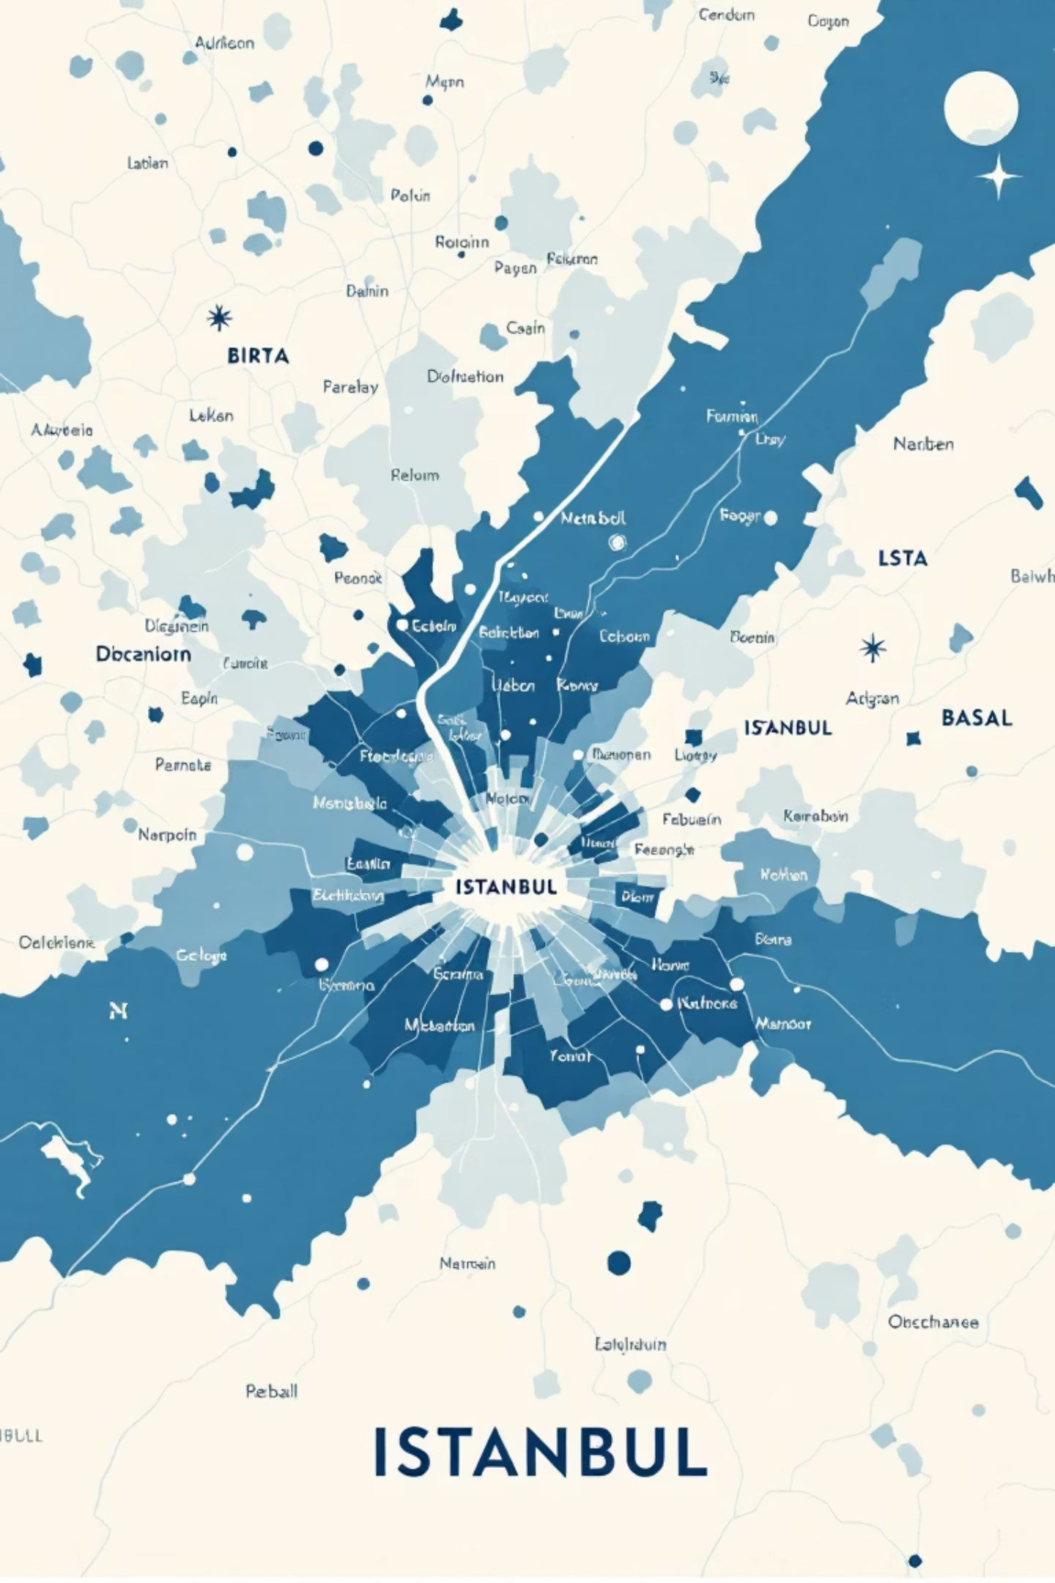
Spatiotemporal Network Insights
Spatial Hotspots
Network usage exhibits significant geographic variation across Istanbul. Districts such as Kadıköy and Beşiktaş demonstrate substantially higher connection volumes, driven by their roles as tourism destinations, commercial hubs, and transit centres. Understanding these patterns enables targeted infrastructure investment where demand is highest.
1
Daily Patterns
Connection volumes peak around midday (12:00–14:00) as commuters, tourists, and office workers utilise public Wi-Fi during lunch hours and breaks.
2
Weekly Rhythms
Business districts show reduced activity on weekends, whilst recreational areas experience significant surges as residents visit parks, cafés, and cultural venues.
3
Strategic Implication
Maintenance schedules can be optimised around predictable low-traffic windows, minimising service disruption whilst maximising operational efficiency.

Slide 8


Predictive Modelling
Model Objective
87%
24
Forecast monthly subscriber demand to support long-term infrastructure planning, budget allocation, and strategic resource deployment across Istanbul's expanding network.
Model Accuracy
Months Forecast
Prediction Horizon
Surpassing our initial target of 85%, demonstrating reliable predictive capability for strategic planning purposes.
Two full years of monthly predictions enabling comprehensive strategic infrastructure planning.
Our model generates a 2-year strategic forecast, providing sufficient lead time for procurement, installation planning, and budget approval cycles.
Limitations: Extreme outliers such as major festivals, sporting events, or severe weather conditions can temporarily impact baseline predictions. The model performs best for steady-state demand forecasting.

Slide 9

Tech Stack & Implementation
Cloud Infrastructure
Version Control
Fully deployed on AWS EC2 instance (Free Tier), ensuring 24/7 availability, global accessibility, and professional-grade reliability without significant infrastructure costs.
Complete source code maintained on GitHub as an open-source project, promoting transparency, collaboration, and continuous improvement through community contributions.
Scalability
Architecture designed to integrate live data streams and handle growing data volumes without significant codebase modifications or performance degradation.
Deployment Strategy
The solution leverages modern DevOps practices including containerisation, automated testing, and continuous integration. This ensures rapid iteration, reliable updates, and seamless integration with IBB's existing IT infrastructure. The free-tier deployment demonstrates feasibility whilst maintaining enterprise-grade functionality.

Slide 10




Impact: Smarter Infrastructure for Istanbul
Operational Efficiency
Transforming public IoT data into a practical tool that directly improves municipal services, reduces infrastructure waste, and ensures optimal network performance across all districts.
Strategic Value
Provides a solid, evidence-based foundation for multi-year budgeting and infrastructure expansion, enabling confident long-term planning and resource allocation.
Citizen Impact
Ensuring reliable, high-speed Wi-Fi access for all citizens—residents and visitors alike—through data-driven planning that anticipates demand before problems emerge.
"By turning connection logs into actionable intelligence, we're not just managing a network—we're building the digital backbone of a smarter, more connected Istanbul."

